Slide 1
Working with Projects in OPP

Slide 2
Agenda
General Information
Creating New Projects
Making a Copy of a Project
Deleting a Project
Ancillary Files

Slide 3
General Information
Projects are the basic working file element within OPP that contain Activities, Resources and network relationships associated with a specific group, team or effort.

Slide 4
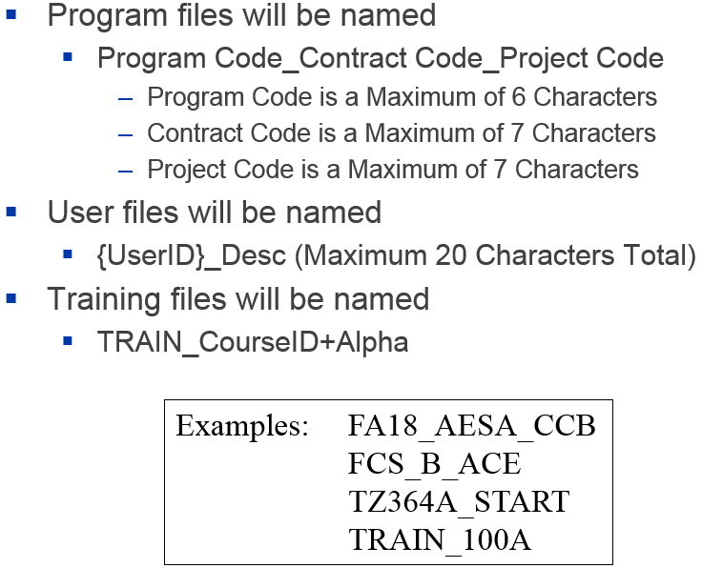
General Information

Slide 5
Creating New Projects

Slide 6
Creating New Projects
An OPP Project can be created a few different ways:
Creating a New Project from Scratch
Creating a New Project Based on an Existing Project
Let’s explore both of these methods…

Slide 7
Creating a New Project from Scratch
Use this feature when you need to create a brand New Project and it doesn’t make sense to benchmark its structure (preferences / ancillary files / accesses / etc.) from an Existing Project.

Slide 8
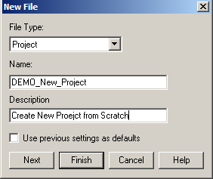
Creating a New Project from Scratch
From the Open Plan Explorer, select File>New>Project
The New File box opens with File Type ‘Project’ already selected
Type in the Name as desired based on the CSPR 3 naming convention.
Type in the Project Description
Click Next

Slide 9
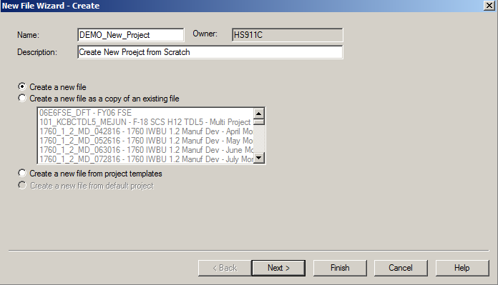
Creating a New Project from Scratch
The New File Wizard – Create box opens
Select the Create a new file option
Click Next

Slide 10
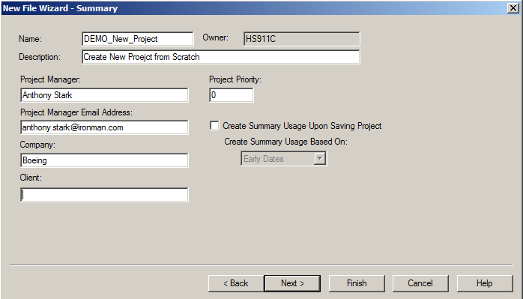
Creating a New Project from Scratch
The New File Wizard – Summary box opens
Populate available fields with information as desired
Click Next
Name of the Project Manager
Email of Project Manager
Your Company Name
Name of client for whom the project is created

Slide 11
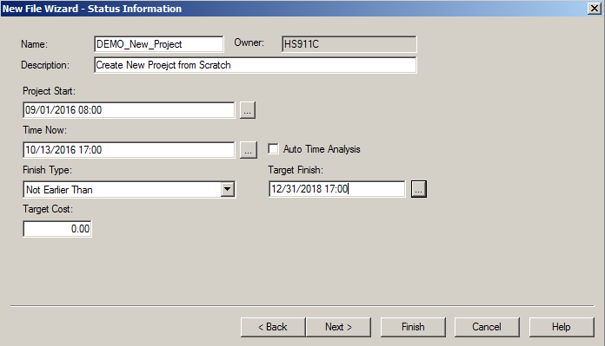
Creating a New Project from Scratch
The New File Wizard – Status Information box opens
Populate available fields with information as needed
Click Next
Historical / Contract Start
Current Status Date
Populate in accordance with CPAR Guidance
Contract Completion
Used for calculations in TA and CP

Slide 12
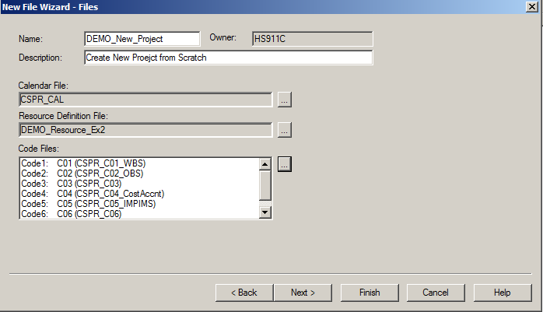
Creating a New Project from Scratch
The New File Wizard – Files box opens
Select the appropriate Calendar / Resource / Code files for your projects
For more information these Ancillary items, refer to their specific training documents
Click Next

Slide 13
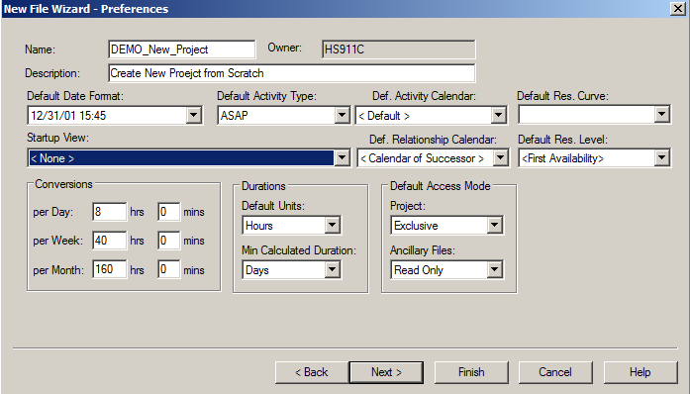
Creating a New Project from Scratch
The New File Wizard – Preferences box opens
Make all the desired selections for DEFAULTS on the project
Click Next
For all new tasks and relationships as default settings
For all new resource assignments as default settings
Format used to display dates in views
View to open automatically when project opened (note impacts anyone who opens project)
Controls the way OPP converts durations into minutes from different units. Recommended settings displayed
Defines the default mode the project / ancillary files will be opened. Recommended settings displayed.
Defines the unit of duration. Due to integration with Cobra, the Recommended settings displayed.

Slide 14
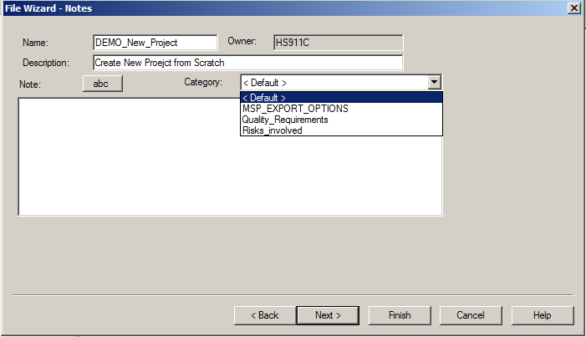
Creating a New Project from Scratch
The New File Wizard – Notes box opens
Populate any desired Project Level notes as desired
Click Next

Slide 15
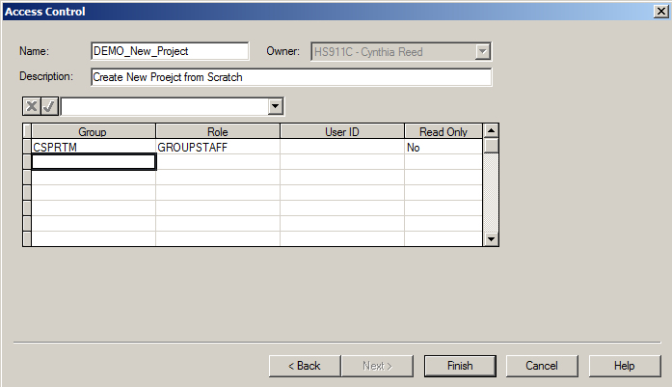
Creating a New Project from Scratch
The Access Control box opens
Populate all of the access groups that require access to the project (always include CSPRTM)
Identify if the groups will have Read Only access, Yes or No
Click Finish

Slide 16
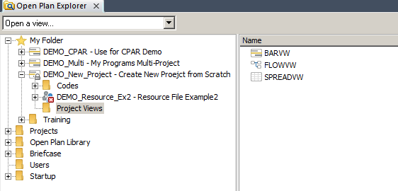
Creating a New Project from Scratch
The new Project has been created and it will be opened in Exclusive mode
Note that there are only 3 views currently attached to your project
Click File>Save to save the newly created Project

Slide 17
Create A New project based on an existing project

Slide 18
Creating a New Project Based on an Existing Project
Use this feature when you need to create a brand New Project and it makes sense to benchmark its structure (preferences / ancillary files / accesses / etc.) from an Existing Project so you don’t have to create it from scratch.
Note, when you create this New Project, even though you are creating it as a ‘copy from’ an existing project, it does not copy any of the activity table/resource table/baseline table/relationship table data into the new project. It simply copies all of the ‘setup’ features of the existing project to the new project (i.e. project preferences / ancillary file assignments / accesses / views /etc.)

Slide 19
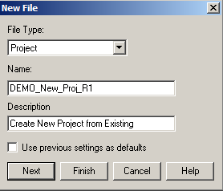
Creating a New Project Based on an Existing Project
From the Open Plan Explorer, select File>New>Project
The New File box opens with File Type ‘Project’ already selected
Type in the Name as desired based on the CSPR 3 naming convention.
Type in the Project Description
Click Next

Slide 20
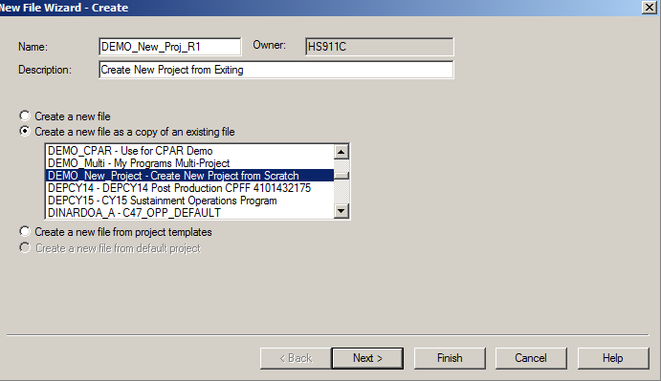
Creating a New Project Based on an Existing Project
The New File Wizard – Create box opens
Select the Create a new file as a copy of an existing file option
Highlight the project to copy from in the window
Click Next

Slide 21
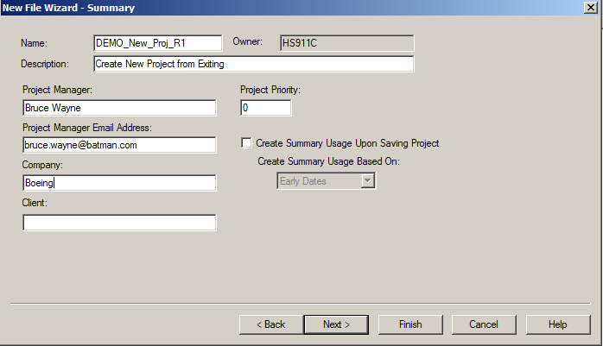
Creating a New Project Based on an Existing Project
The New File Wizard – Summary box opens
Make updates to fields as needed (pre-populated based on values in project coping from)
Click Next
Name of the Project Manager
Email of Project Manager
Your Company Name
Name of client for whom the project is created

Slide 22
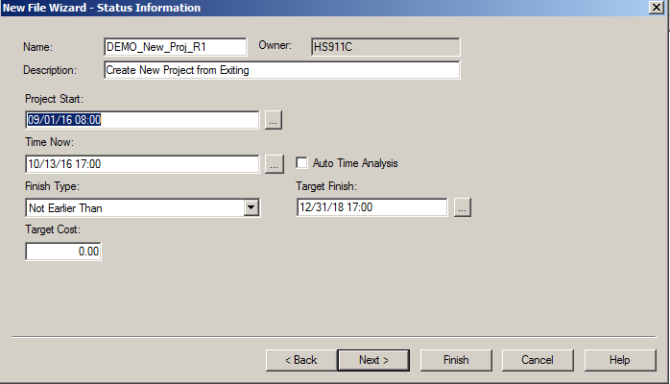
Creating a New Project Based on an Existing Project
The New File Wizard – Status Information box opens
Make updates to fields as needed (pre-populated based on values in project coping from)
Click Next
Historical / Contract Start
Current Status Date
Populate in accordance with CPAR Guidance
Contract Completion
Used for calculations in TA and CP

Slide 23
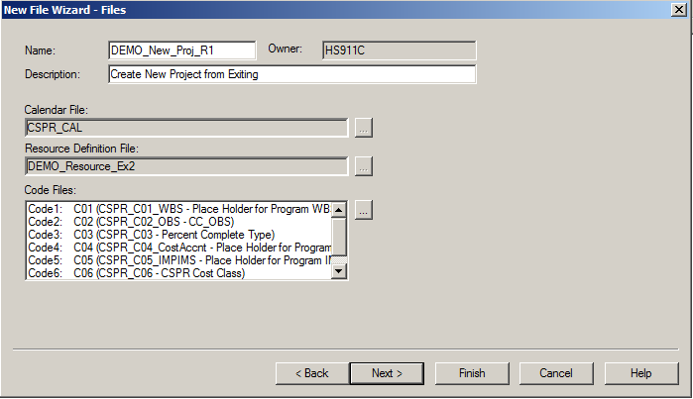
Creating a New Project Based on an Existing Project
The New File Wizard – Files box opens
Make updates to ancillary file assignments as needed
Click Next

Slide 24
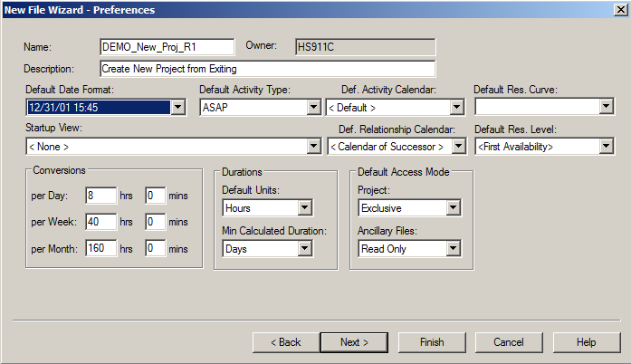
Creating a New Project Based on an Existing Project
The New File Wizard – Preferences box opens
Make any updates as needed, all selections currently based on project coping from
Click Next
For all new tasks and relationships as default settings
For all new resource assignments as default settings
Format used to display dates in views
View to open automatically when project opened (note impacts anyone who opens project)
Controls the way OPP converts durations into minutes from different units. Recommended settings displayed
Defines the default mode the project / ancillary files will be opened. Recommended settings displayed.
Defines the unit of duration. Due to integration with Cobra, the Recommended settings displayed.

Slide 25

Creating a New Project Based on an Existing Project
The New File Wizard – Notes box opens
Populate any desired Project Level notes as desired
Click Next

Slide 26
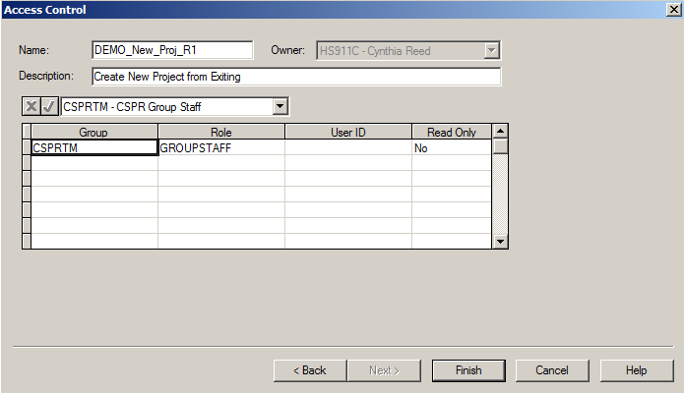
Creating a New Project Based on an Existing Project
The Access Control box opens
Update the access groups for those who require access to the project (always include CSPRTM)
This will default with existing access assignments from project coping from
Identify if the groups will have Read Only access, Yes or No
Click Finish

Slide 27
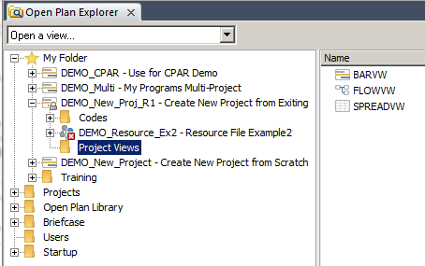
Creating a New Project Based on an Existing Project
The new Project has been created and it will be opened in Exclusive mode
Note this project will inherit all views that were assigned to the project you copied from
Click File>Save to save the newly created Project

Slide 28
Make a copy of a project

Slide 29
Make a Copy of a Project
Use this feature when you need to have a copy of an existing project with all of the Activity table/Resource table/Baseline table/Relationship table, ancillary files, project preferences, views, etc. retained at a certain point in time.
This is useful for many purposes, some of which include:
CDRL Deliverables (week or month-end copies)
CPAR processing & Weekly Schedule Reporting
What If analysis
Brown Room / Green Room processing

Slide 30
Make a Copy of a Project
There are two ways to make a copy of a project. You can perform a File>Save As…, or you can use the Project Copy Tool in the Plug and Play menu (which is 5 times faster)
For specifics about Making a Copy of a Project, refer to the ‘CSPR3 OPP PNP Project Copy Tool’ training material.

Slide 31
Delete a project

Slide 32
Deleting a Multi-Project
Database cleanup is key to maintaining ideal performance within the system. One of those ways is deleting older, unused, no longer needed projects.
First ensure the project is not required for any kind of contract requirements. Then if you are free to delete it, follow the steps on the next slide to do so.

Slide 33
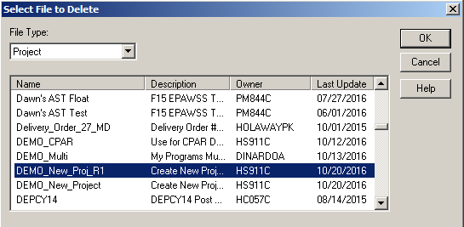
Deleting a Project
From the Open Plan Explorer, select File>Manage Files>Delete
The Select File to Delete box opens with File Type ‘Project’ already selected
Scroll down and select the project you want to delete
Click OK

Slide 34
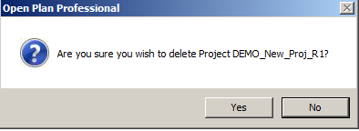
Deleting a Project
A verification message appears asking you if you’re sure you want to delete that project
Answer Yes, after you’ve confirmed the correct project name is listed
Once complete, the Project will no longer appear in the Projects list.
If it were linked in your My Folder, that link is removed
None of the views or ancillary files are deleted, simply the links to that project are removed

Slide 35
ancillary files

Slide 36
Ancillary Information
Calendar Files
Resource Files
Code Files

Slide 37
Calendar Files
All projects should have a Calendar file attached to it for use in controlling when work can be performed.
By attaching a calendar, you can define working days, non-working days, holidays and even define the work day hours.
If a calendar is not attached to a project, Open Plan performs all calculations based on a 5-day work with no holidays, and an 8-hour work day.
For specifics about Calendar Files, refer to the ‘CSPR3 OPP Working with Calendar Files’ training material.

Slide 38
Resource Files
To be able to resource load a project, there first must be a Resource File attached to the project
For specifics about Resource Files, refer to the ‘CSPR3 OPP Working with Resource Files’ training material.

Slide 39
Code Files
Code files allow project data to be summarized, or filtered to appropriate levels for specific reporting requirements. Codes can include things like OBS, WBS, and SOW.
For more information about Code Files, refer to the ‘CSPR3 OPP Working with Code Files’ training material.

Slide 40
CHANGE LOG
DATE | SLIDE | DESCRIPTION OF CHANGE
10/20/16 | All | Created new for OPP 8.0

